Slide 1

Is Tesla Equity Outperforming the Market for the next 5, 10 and 15 Years?

Slide 2
Data needed:
Growing Industry
Market size, CAGR of EV market (Global and US market),
Yearly sales of EV vs gas vehicle – to show the uptrend of EV sales?
EV sales portion vs New car sales
Diversification Effect:
TSLA revenue breakdown by region, customer breakdown by region (use the map)
Other regional data ?
Social Impact:
CO2, environment, death rate of TSLA
Financial:
TSLA Financials: EBITDA, capex, profitability, risk of the investment
TSLA valuation- comps model
Stock Price Performance and Simulation:
Historical stock price of TSLA and NASDAQ (and probably one main competitor of TSLA) from 2015-2020
Bond yield – US treasury, municipal bonds from 2015-2020
Monte Carlo simulation for the next 5, 10 and 20 years

Slide 3
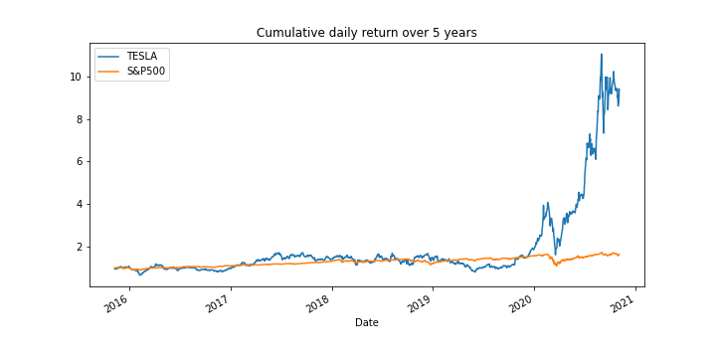
TSLA-Historical price Analysis for the last 5 years
TSLA vs S&P500
Source ：Alpaca trade API / Yahoo Finance

Slide 4
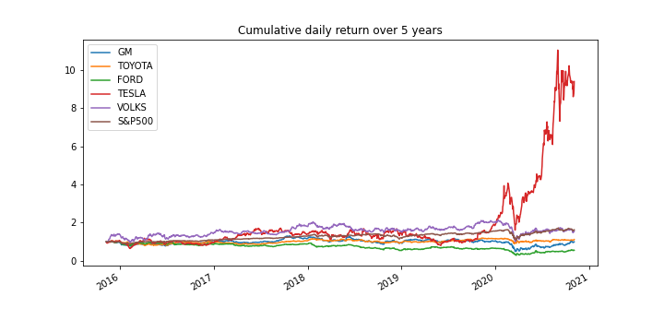
TSLA-Historical price Analysis for the last 5 years
TSLA vs main competitor
Source ：Alpaca trade API / Yahoo Finance

Slide 5
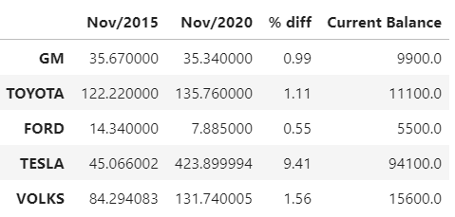
TSLA-Historical price Analysis for the last 5 years
Stock price
If you had invested $10,000 in TESLA stock 5 years ago your current balance would be $94,100
Source ：Alpaca trade API / Yahoo Finance

Slide 6
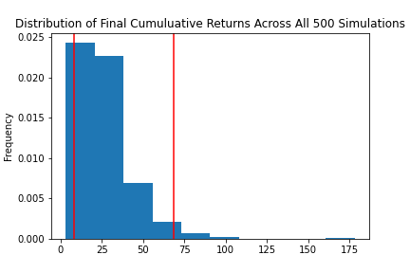
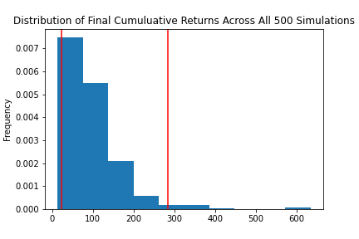
TSLA-Sensitivity Analysis for next 20 years
Monte Carlo Simulation Portfolio Without Tesla
Monte Carlo Simulation Portfolio With Tesla
With an initial investment of $10,000 in your portfolio you have a 95% chance it will be within the range of $82,972.21 and $683,666.61 over the next 20 years
With an initial investment of $10,000 in your portfolio you have a 95% chance it will be within in the range of $226,781.95 and $2,835,449.51 over the next 20 years
Portfolio = Apple Inc. , Alphabet Inc. , Johnson & Johnson , Berkshire Hathaway Inc.
Source ：Alpaca trade API / Yahoo Finance

